Slide 1
Random Forest Performance chart
Adanna Alutu
Septa Train project

Slide 2
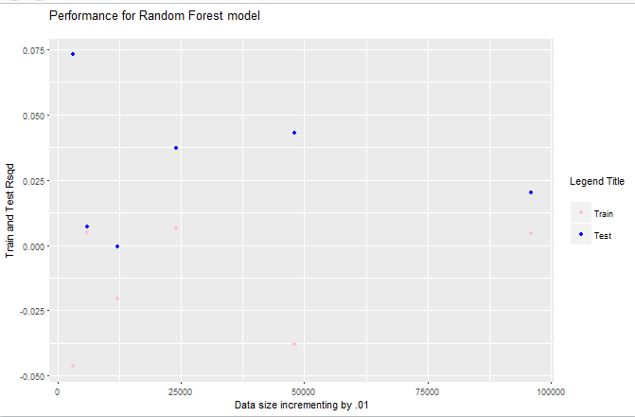
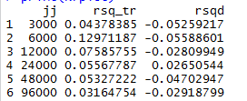
Performance at different data levels
From the table on the left, the Training data performed better than the Test data at each incremented data sample.
Out of 100,000 data used for the project, only 6000 records (~6% of the dataset) is sufficient to achieve the best performance for the Training dataset while the Test data needs 24,000 records (~24% of the data) to reach a performance > 0, ~ 3%.

